Slide 1

LaunchCode Liftoff
Class 5
Hank DeDona
5/4/2020

Slide 2
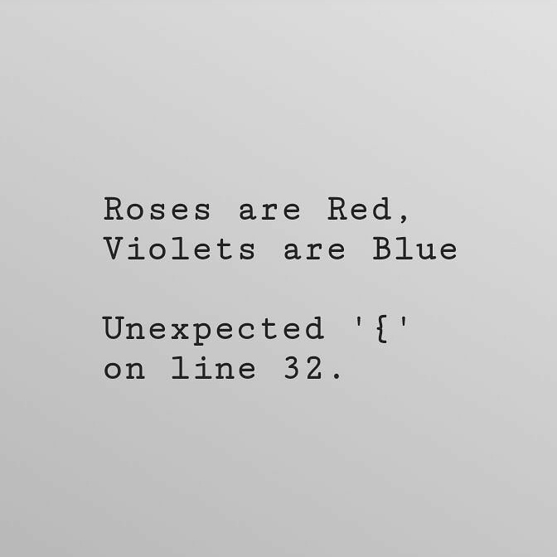
Agenda
Objectives and Timeline
Assignment: Live Coding Interview
Activity
Scrum
Live Coding Interview
Mentor Project Feedback

Slide 3
Liftoff Project Timeline
Address Feedback
Next Features Behavioral Interview
Class 5
Class 7
Class 6
Class 8
Next Features
Final Review
Notes:
Resume Aug 21st

Slide 4
Live Coding

Slide 5

Live Coding - Goals
Interviewers are looking for candidates who...
...ask questions to fully understand the problem.
...work towards a correct solution.
...has an understanding of the language syntax.
...demonstrates how to test the solution.
...addresses any bugs.
...can communicate their thought process.

Slide 6
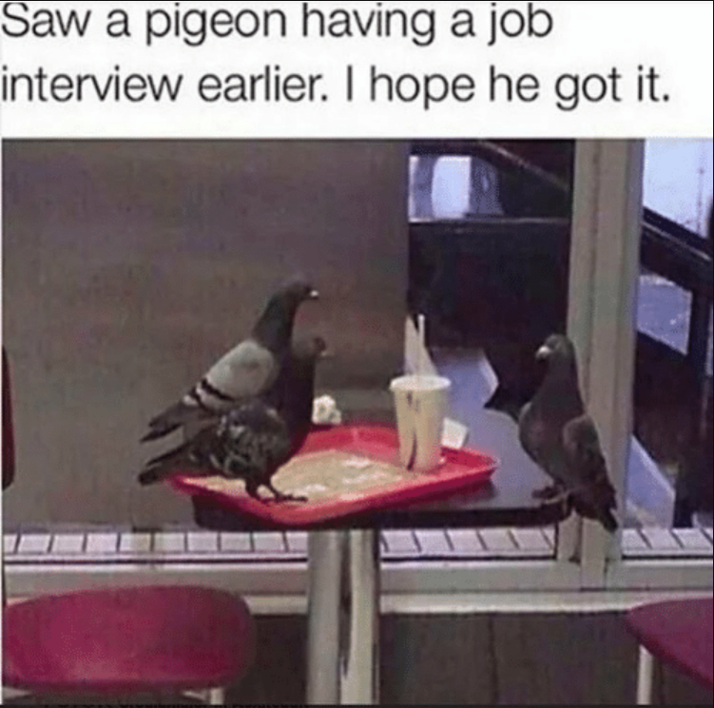
Live Coding - Process
Gather Requirements
Break Problem Down
Pseudocode
Write Syntax
Test
Make Changes
https://education.launchcode.org/liftoff/videos/live-coding/

Slide 7
Activity - Live Coding Interview
Find Your Assigned Interviewer
Shared in Slack #general
Note Their Station
Be Prepared for only 15 Minutes
Ask for more feedback!

Slide 8
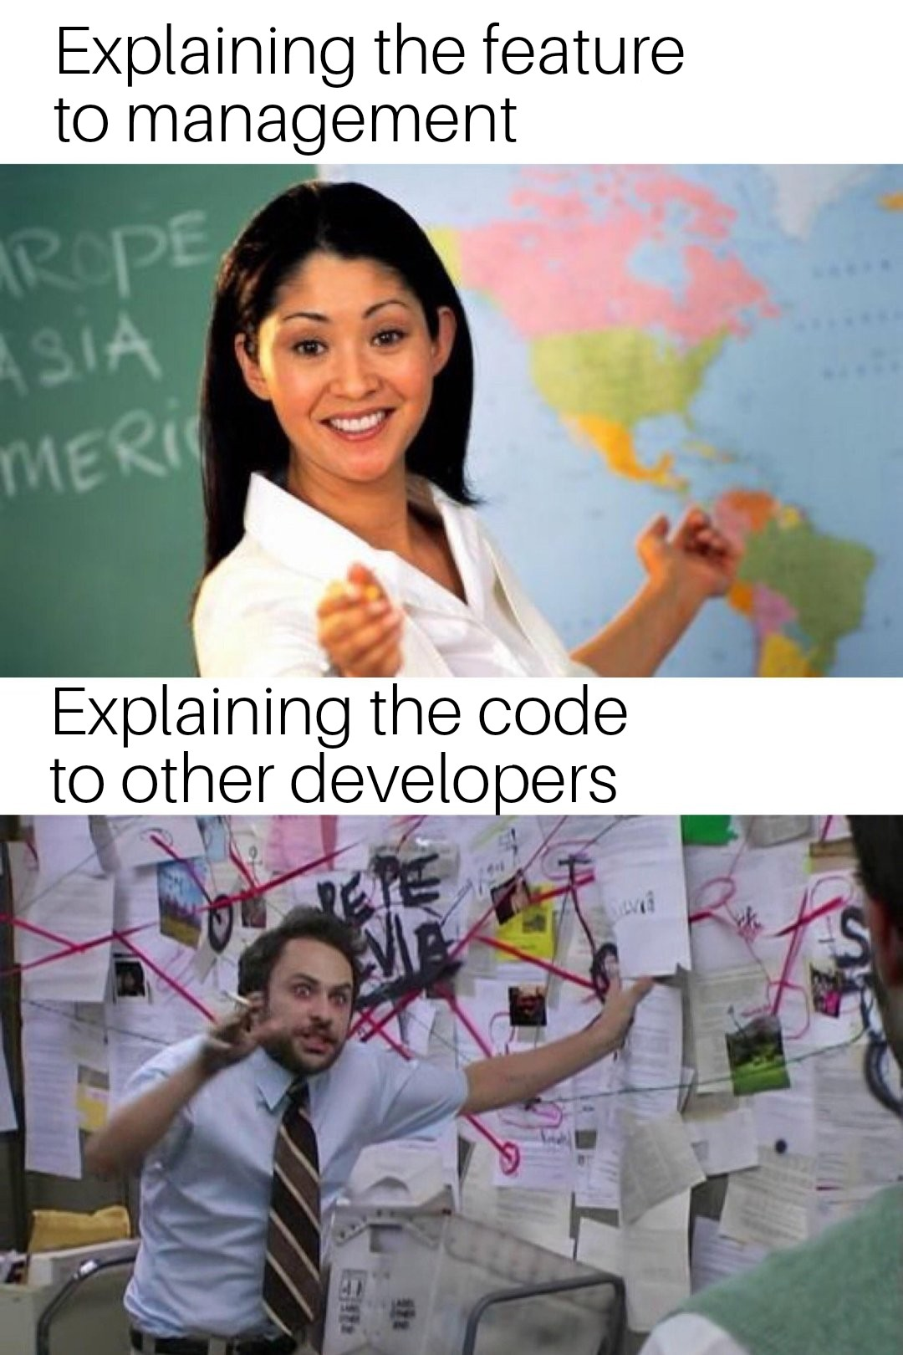
Activity - Scrum (15 mins)
1 Minute Per Person
What You Did
What You’re Working On Next
Any Blockers
Remainder:
Mentor Project Feedback

